Slide 1
Income Classification
Rohan Rao

Slide 2

Task
Summary
To train a Binary Classification model to predict whether the salary of an individual is less than or greater than $50,000 based on several factors such as age, sex etc.
It is a supervised clustering project with two classes
Dataset
I will be using a dataset that consists of census data that includes features such as age, sex, education and a target with two classes (<=50K, >50K)
32561 samples in raw data
Dataset Link: https://www.kaggle.com/datasets/lodetomasi1995/income-classification
Models
Logistic regression, Random forest classifier, Support Vector Classifier
Notes:
In this project I will be conducting regression analysis on a dataset of Uber trips in New York to predict the fares of potential trips. My goal is to train a machine learning model that can accurately predict the fare of an Uber taxi ride given relevant information such as the pickup and drop-off longitude and latitude, time of day, and distance traveled. To do this, we will use regression techniques to build a model that can make continuous predictions.
In this project, I will try to cover the following steps:
Data preparation, cleaning and exploratory data analysis
Model selection and training
Model evaluation and improvement

Slide 3
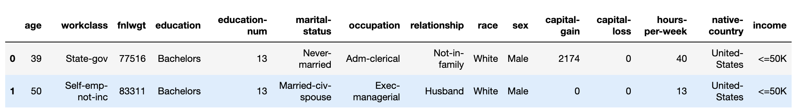
Data
Pre-Processed Data
Number of samples | 32561
Target | income (categorical variable)
Number of features | 14 (8 categorical; 6 numerical)
Missing Values | 0 (initially)
Duplicate Values | 0

Slide 4
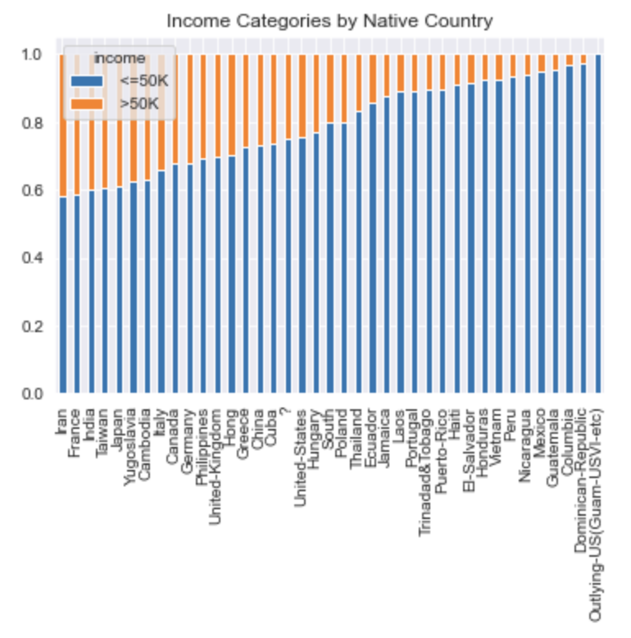
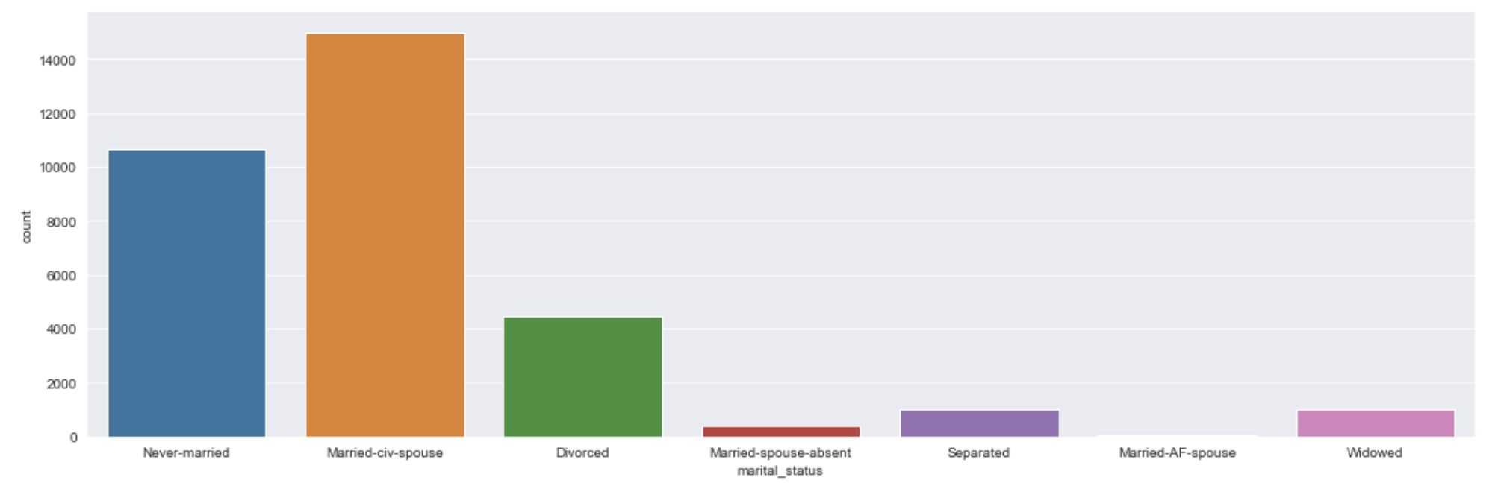
EDA
Every column name and categorical values had extra spaces, so I stripped the columns
For the values, I plotted them for both target classes
Merged minority classes together to reduce bias and improve accuracy
Found ‘?’ class in different columns and replaced them with nan

Slide 5
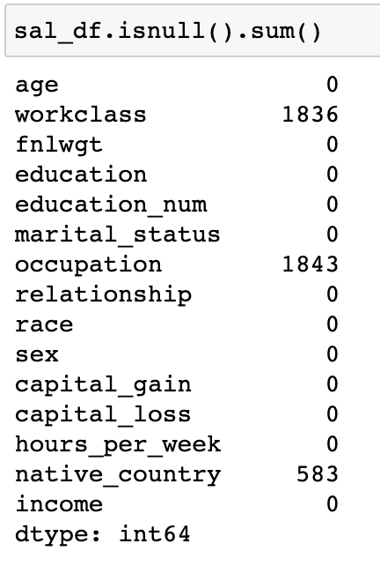
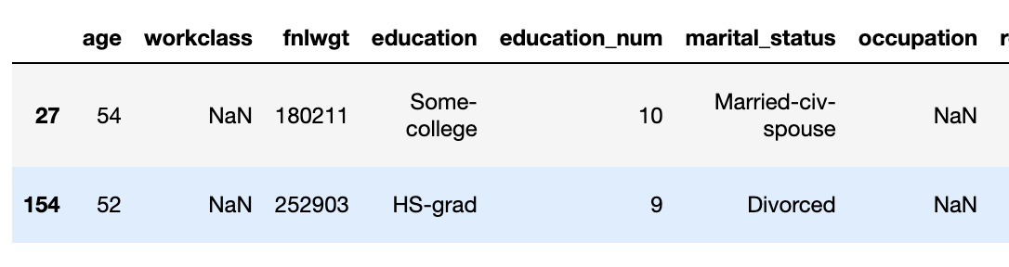
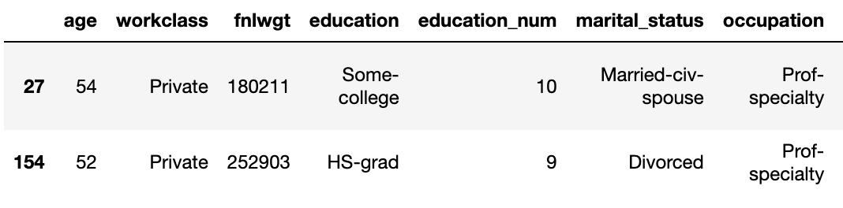
The dataset was imbalance
More values in the <=50K class than >50K
Remove null value samples from majority class (<=50K)
Used a SimpleImputer to impute the missing values in minority class (>50K)
Most frequent strategy to fill null values

Slide 6
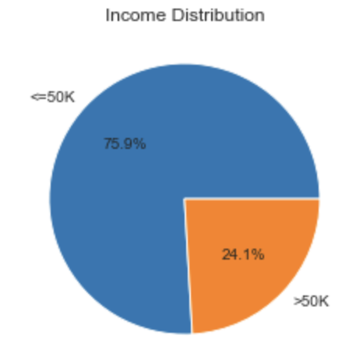
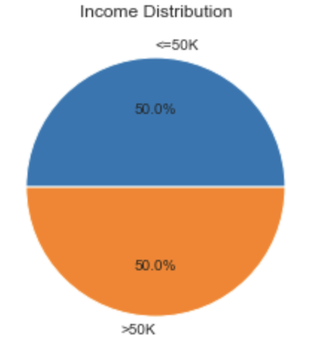
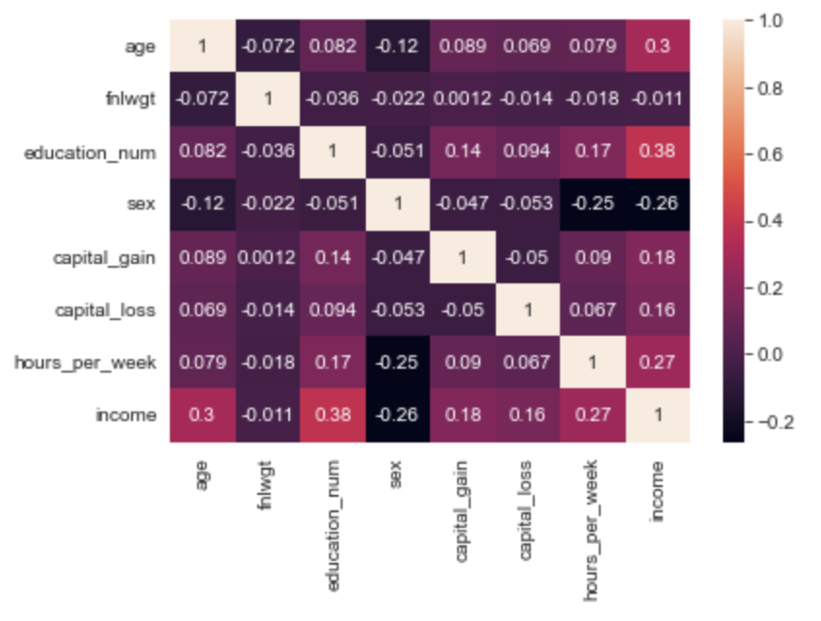
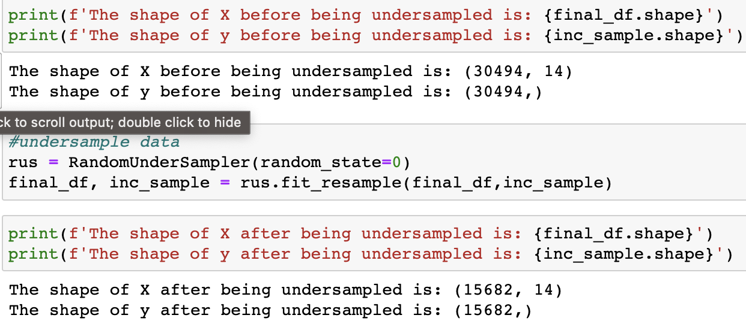
To balance dataset, I used a random undersampler to reduce number of samples in majority class
Imbalanced data can pose a challenge for binary classification algorithms because they tend to be biased towards the majority class.

Slide 7
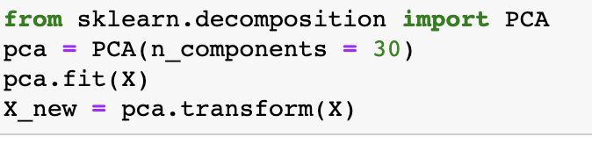
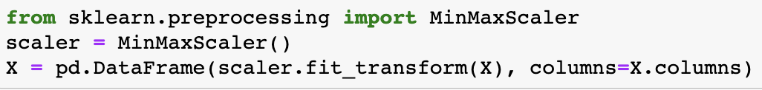
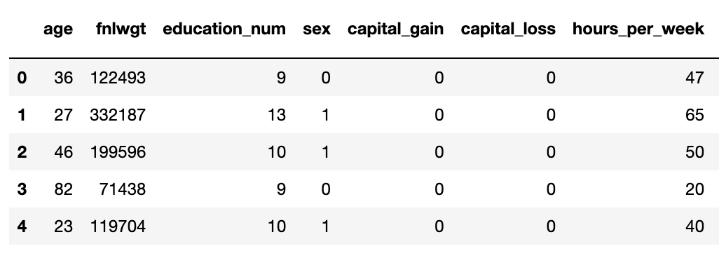
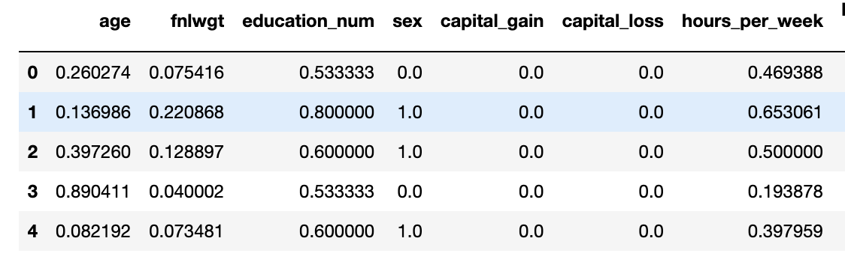
After one-hot-encoding we get 100 features
Used MinMaxScaler() to scale features
To reduce dimensionality, I used PCA to reduce it
Used trial and error to find ideal n_components

Slide 8
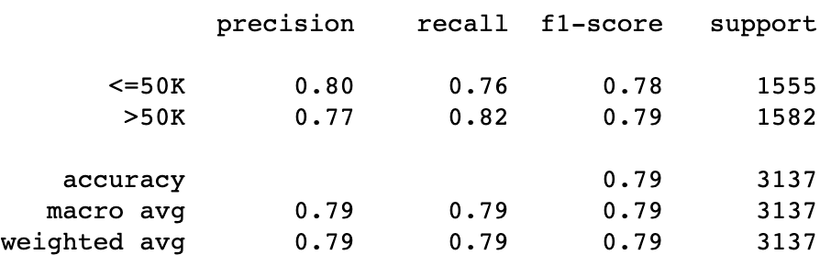
Models
Model | Logistic Regression
Parameters | GridSearchCV: 'penalty': ['l1', 'l2'], 'C': [0.1, 0.5, 1, 5, 10, 50], 'solver': ['liblinear'] Best: 'C': 0.5, 'penalty': 'l2', 'solver': 'liblinear'

Slide 9
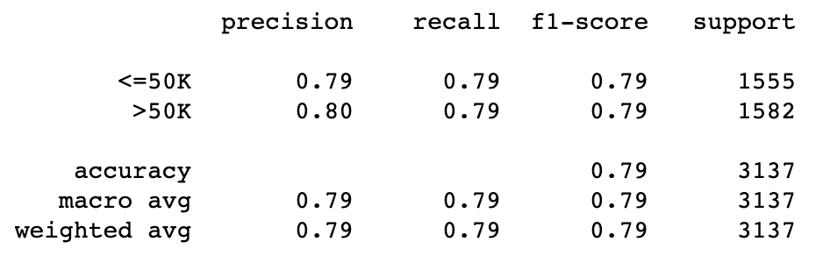
Models
Model | Random Forest Classifier
Parameters | GridSearchCV: 'n_estimators': [50, 100, 200], 'max_depth': [10, 20, 30, 40, None], 'min_samples_split': [8, 10, 12], 'min_samples_leaf': [3, 4, 5], 'max_features': ['sqrt', 'log2', 2, 3] Best: 'max_depth': None, ‘'max_features': 2, 'min_samples_leaf': 5, 'min_samples_split': 10, 'n_estimators': 200

Slide 10
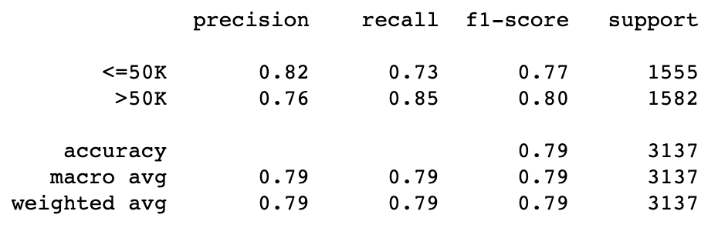
Models
Model | Support Vector Classification
Parameters | GridSearchCV: 'C': [0.1, 1, 10], 'kernel': ['linear', 'poly'], ‘degree': [2, 3, 4], 'gamma': ['scale', 'auto'] Best: 'C': 1, 'degree': 2, 'gamma': 'scale', 'kernel': 'poly'

Slide 11
Model Comparison
Logistic Regression
Random Forest Classifier
SVC
Potential Solutions:
Try different ratio of training and testing data (70:30)
Use RandomizedSearchCV on a larger parameter grid
Using more complex models
Use different PCA dimensions

Slide 12
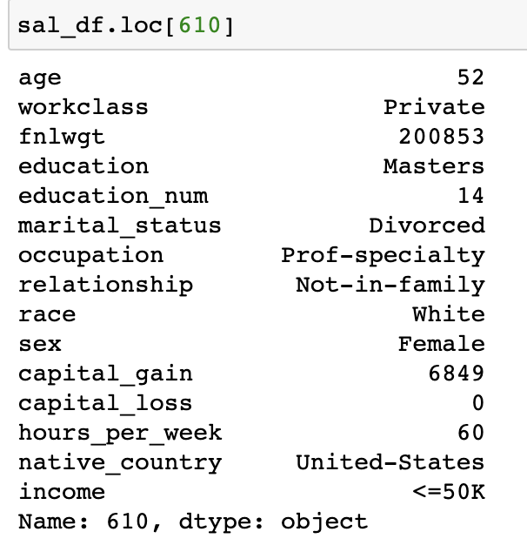
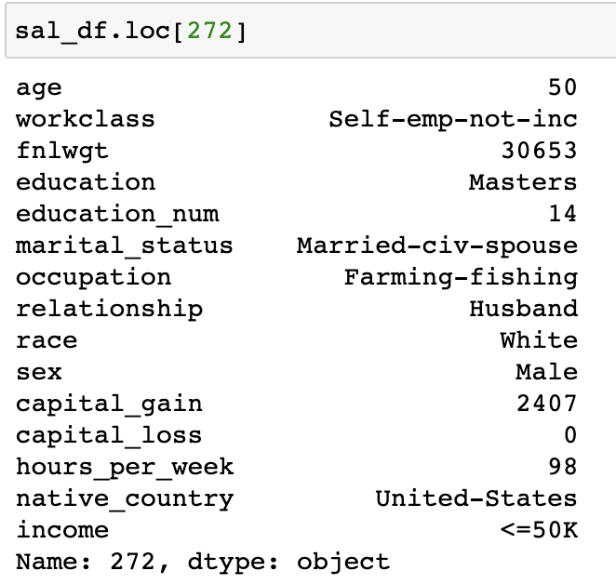
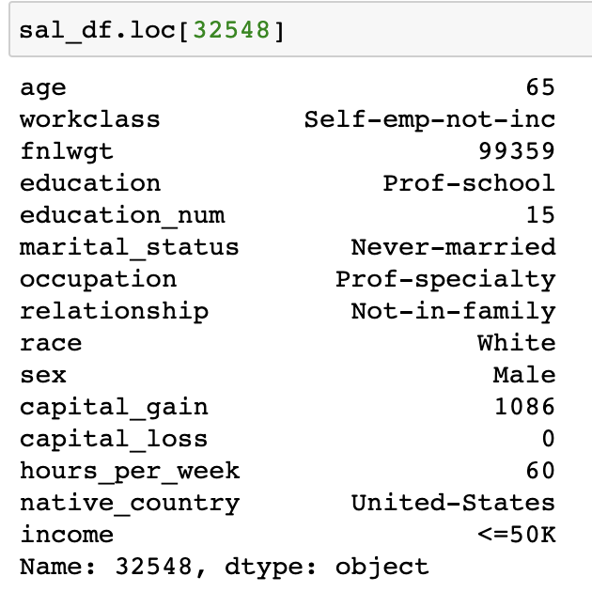
Error Analysis
Found values that were incorrectly predicted
Can see a pattern in data as all the samples have a high education number and large hours_per_week
Possible Solutions could be to generate data such as this as it is quite rare or maybe reduce the importance of those features

Slide 13
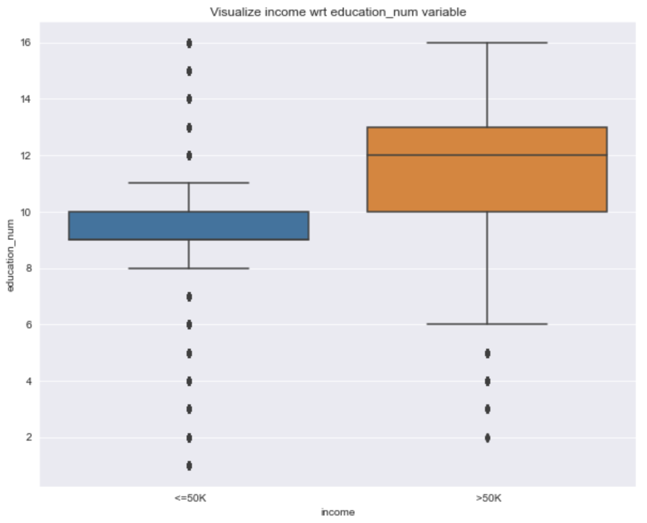
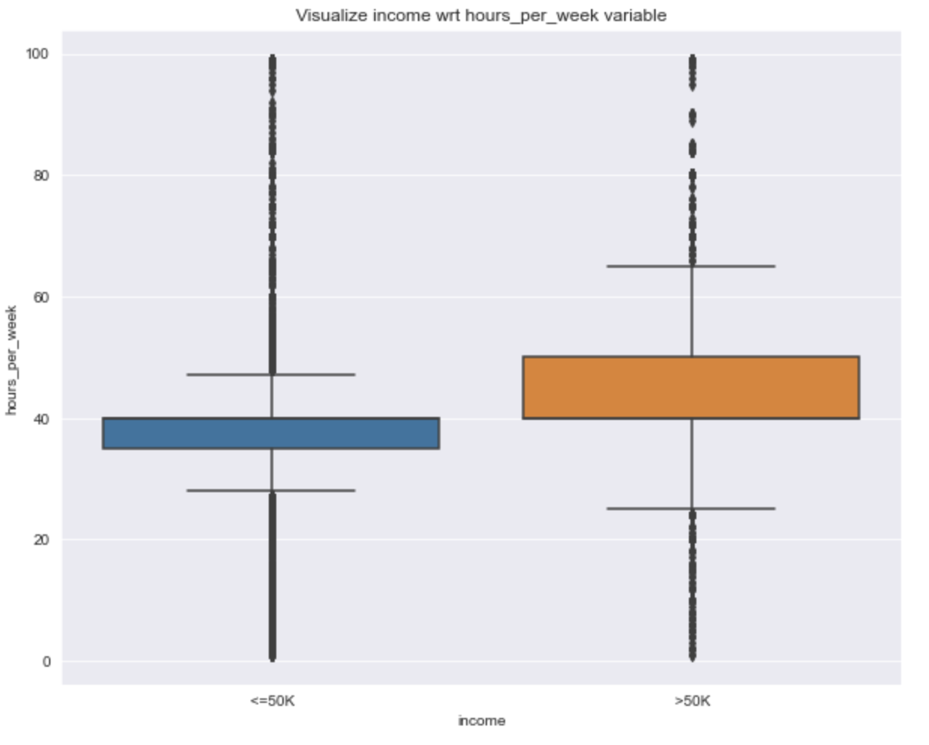

Slide 14
Thank You!

